Slide 1
Chemistry 141 − Fall 2016
Cary Willard
Office 30-224
Phone 644-7427
cary.willard@gcccd.edu
www.grossmont.edu/cwillard/

Slide 2
Class Schedule
Lecture
Tuesday and Thursday 9:30 – 10:50 am
Room 30-250
Lab
Monday and Wednesday 8:00 – 10:50 am
Room 30-240

Slide 3
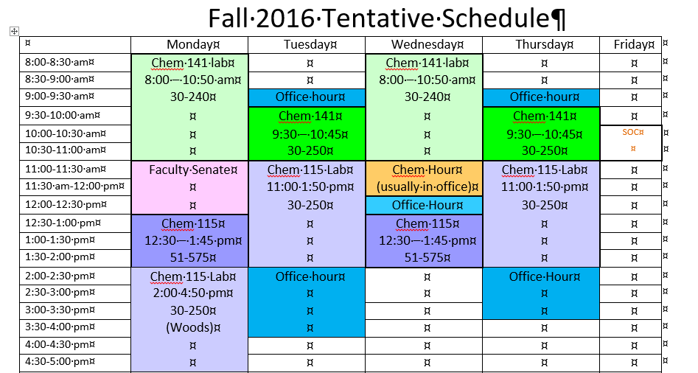
Tentative Schedule

Slide 4
All Course documents will be on either my web page
www.grossmont.edu/cwillard
Or blackboard
www.gcccd.blackboard.com

Slide 5
This course is the first semester of the two-semester general chemistry course for science, engineering, and pre-professional majors
You should know how to do stoichiometry, solution problems, and the gas laws.
You should know basic chemical nomenclature.
You must be comfortable working with basic laboratory equipment such as balances, burets, pipets, etc.

Slide 6
Prerequisites
Chemistry 120 or equivalent.
Good working knowledge of intermediate algebra.

Slide 7
Text
Chemistry, A Molecular Approach 3rd or 4th edition or custom Grossmont edition, by Nivaldo J. Tro
Mastering Chemistry Electronic Homework
Available through blackboard
Lab Manual (compiled by Grossmont Faculty)
(Available either at bookstore or online at http://www.grossmont.edu/cwillard/labs.htm)
Lab Notebook
May use composition book or lab manuals from bookstore.

Slide 8
Additional Requirements
Safety Glasses
Covered Shoes
Non-erasable Ink Pen
Scientific Calculator with Logs and Exponents

Slide 9
Student Learning Outcomes:
This course is both a lecture and a lab course. Our major goals for the semester are to become fluent in the language of chemistry and to utilize the tools of chemistry to analyze a variety of chemical phenomena. We will also explore the behavior of materials in the laboratory and use our knowledge of chemistry to explain that behavior.
In particular, each student will be able to do the following upon completion of this course:
Demonstrate a working knowledge of the language of chemistry.
Apply quantitative reasoning to chemical problems
Apply a laws and theories to explain and predict the properties of atoms and molecules.
Employ laboratory equipment and techniques to collect, organize and evaluate experimental data.

Slide 10
Course Objectives
Upon successful completion of this course the student should be able to:
Solve stoichiometry problems involving mass, moles, mixtures, gas volumes, and limiting reactants.
Solve gas problems using the ideal gas, combined gas, Dalton’s partial pressure, and Graham’s effusion laws.
Demonstrate proficiency in chemical nomenclature.
Identify and balance net ionic equations for oxidation reduction, acid base and precipitation reactions.
Demonstrate quantitative and qualitative understanding of chemical equilibrium,
Demonstrate understanding of chemical periodicity in terms of quantum mechanics and atomic structure.
Analyze the bonding in chemical compounds in terms of Lewis structures, VSEPR, VB and MO theory.
Calculate enthalpies of reactions using Hess’ law, bond energies, and calorimetry.
Apply the first and second laws of thermodynamics to chemical systems
Solve colligative property problems and explain solution properties in terms of vapor pressure and intermolecular interactions.
.Demonstrate ability to analyze a phase diagram.
Apply science methodology in a laboratory setting.
Demonstrate proficiency in quantitative chemical analysis techniques.
Apply kinetic molecular theory to describe the properties of solids, liquids and gases.
Demonstrate correct documentation of experimental data in laboratory notebook and presentation of analysis in a formal lab report.
Solve problems involving the relationship of pH, pOH, and K_{w} in aqueous solution.

Slide 11
Grading
Quizzes 15%
Given in lab, cover lecture and lab material
Exams 40%
Given in lab
Homework 10%
Mastering Chemistry/other assignments
Lab 25%
Final Exam 10%
Cumulative multiple choice final

Slide 12
Grading Scale
A 88%
B 78%
C 67%
D 55%
Must pass both lab and lecture to pass course!
Course grade will be no more than 1 letter grade higher than Exam and Quiz average.

Slide 13
Make-up Policy
Quizzes - No make up allowed. Lowest quiz will be dropped.
Exams - Must be make up within 1 week of original test date. (With a reasonable, verifiable excuse).

Slide 14
Late Work
Labs - lose 20% per week late. No labs accepted more than 2 weeks late. Due dates on schedule.
Computer homework assignments lose up to 20% if completed late.

Slide 15
Attendance
Regular attendance is mandatory - you may be dropped if you miss more than 9 hours of class (1 week).
You will not be dropped if you have not checked out of the laboratory! This means you will receive an F!!!!
If you miss even one day the first 2 weeks you will be dropped and another student will be given your space!

Slide 16
Academic Integrity Policy
All work must be your own!
Calculators will not contain cheat sheets!
Grossmont College Academic Integrity Policy
Cheating and plagiarism (using as one's own ideas writings, materials, or images of someone else without acknowledgement or permission) can result in any one of a variety of sanctions. Such penalties may range from an adjusted grade on the particular exam, paper, project, or assignment (all of which may lead to a failing grade in the course) to, under certain conditions, suspension or expulsion from a class, program or the college. For further clarification and information on these issues, please consult with your instructor or contact the office of the Associate Dean of Student Affairs.

Slide 17
Accommodations for Students with Disabilities:
Students with disabilities who may need accommodations in this class are encouraged to notify the instructor and contact Disabled Student Services & Programs (DSP&S) early in the semester so that reasonable accommodations may be implemented as soon as possible. Students may contact DSP&S in person in room 110 or by phone at (619) 644-7112 (voice) or (619) 644-7119 (TTY for deaf).

Slide 18
Supervised Tutoring Referral
Students are referred to enroll in the following supervised tutoring courses if the service indicated will assist them in achieving or reinforcing the learning objectives of this course:
IDS 198, Supervised Tutoring to receive tutoring in general computer applications in the Tech Mall;
English 198W, Supervised Tutoring for assistance in the English Writing Center (Room 70-119); and/or
IDS 198T, Supervised Tutoring to receive one-on-one tutoring in academic subjects in the Tutoring Center (Room 70-229, 644-7387).
To add any of these courses, students may obtain Add Codes at the Information/Registration Desk in the Tech Mall.
All Supervised Tutoring courses are non-credit/non-fee. However, when a student registers for a supervised tutoring course, and has no other classes, the student will be charged the usual health fee.

Slide 19
Please turn off cell phones during class and if you know you will be receiving calls during lecture let me know in advance, set phone to vibrate, and sit near the door.

Slide 20
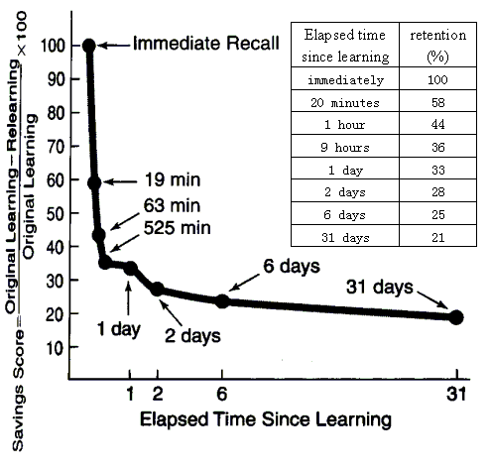
You Can Beat the Forgetting Curve!
*Notice how only ~20 minutes after lecture a typical student loses 40% of what he or she learned during lecture!
*Block out time after every lecture to review and annotate your notes, look over figures in the book, and do a study guide question or two. Block out time later that day, the next day, and at least once a week to do more review.
*Each time you review you will be amazed at how much easier it is to remember everything, even as you add more information with each review.
It IS possible to become more intelligent over the semester- the more you learn and train your brain to learn the better your neuron connections are…which makes you more intelligent.
Learning will become easier in the future!
You just have to practice consistently to see the results.

Slide 21
What is Chemistry?
Chemistry is the science of the properties, composition, and behavior of materials.
Chemistry is the science concerned with describing and explaining the different forms of matter and the chemical reactions of matter.
Practice problems Tro – 1.2

Slide 22
Branches of Chemistry
Applied Chemistry - the search for and isolation of useful materials.
Theoretical Chemistry - Provides a chemical view of nature and explanations of natural processes.

Slide 23
Chemistry is the Central Science

Slide 24
Scientific Method
Observation – a statement that accurately describes something we see, hear, taste, feel, or smell.
Conclusion – a statement that is based on what we think about a series of observations.

Slide 25
Observations and Conclusions
Before fermentation, grape juice is very sweet and contains no alcohol.
After fermentation, the grape juice is no longer as sweet and it contains a great deal of alcohol.
In fermentation, sugar is converted into alcohol.

Slide 26
From Scientific Method
Empirical facts
(observations, data)
Scientific laws
(tested generalizations, consistent observations)
Hypothesis
(tentative explanation)
Theory or Models
(tested explanation, unifying explanation for a set of observations, facts and laws)

